Slide 1
LECTURE # 01
Software Construction and Development SE-312
Introduction to Software Construction
Course Instructor: Engr. Ruqqiya Asad
‹#›
Notes:
‹#›

Slide 2
Objectives
Contents
What is Software Construction
Importance of Software Construction
Software Development Process
6 Stages of Software Development Process
‹#›
Notes:
‹#›

Slide 3
Why This Course?
Ever used an app that crashes?
App that works today but fails after update?
Software failure is not only coding issue
It is a construction & development problem
This course teaches how to build quality software
‹#›

Slide 4
What is Software Construction & Development?
Software construction is more than coding
Focuses on:
Planning
Writing clean code
Error handling
Testing
Maintenance
Key Idea:
Good code works today Good construction works forever
‹#›

Slide 5
Software Construction
• Construction is the work “construction workers” do when they build a house, a school, or a skyscraper.
• In common usage, construction refers to the process of building.
• The construction process might include some aspects of planning, designing, and checking the work, but mostly construction refers to the hands-on part of creating something.
‹#›

Slide 6
Software Construction
Software construction is a software engineering discipline.
It is detailed creation of working, meaningful software through a combination of coding, verification, unit testing, integration testing, and debugging.
‹#›
Notes:
‹#›

Slide 7
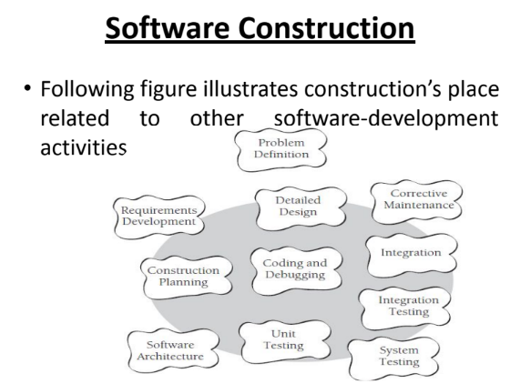
‹#›

Slide 8
Software Construction
• Some of the specific tasks involved in construction are:
Verifying that the groundwork has been laid so that construction can proceed successfully
Determining how your code will be tested
Designing and writing classes and routines
Creating and naming variables and named constants
Selecting control structures and organizing blocks of statements
Unit testing, integration testing, and debugging your own code
Reviewing other team members’ low-level designs and code and having them review yours
Polishing code by carefully formatting and commenting it
Integrating software components that were created separately
Tuning code to make it faster and use fewer resources
‹#›

Slide 9
Software Construction
• Important non-construction activities include
Management
requirements development
software architecture
user-interface design
system testing
maintenance.
‹#›

Slide 10
Software Construction
• Construction is also sometimes known as “coding” or “programming.”
Do you think both these words correctly portray the term construction?
‹#›

Slide 11
Importance of Software Construction
• Software Construction is an important part of software development because
Construction is a large part of software development
Construction is the central activity in software
development
With a focus on construction, the individual programmer’s productivity can improve enormously
Construction’s product, the source code, is often the only accurate description of the software
Construction is the only activity that’s guaranteed to be done
‹#›

Slide 12
Software Development Process
Software Development Process is dividing the software development into tiny, sequential steps to enhance the product, project, and design altogether.
The iterative logical process for software program development or application development to cater to the
needs of any business or personal objectives is known as ‘Software Development’.
‹#›

Slide 13
6 Stages of Software Development Process
a. Requirements Analysis and Resource Planning
b.Design and Prototyping
c. .Software Development
d. Testing
e .Deployment
f. Maintenance and Updates

Slide 14
Requirements Analysis
Purpose: Understand what the system should do and gather all user needs.
In this stage, developers, analysts, and stakeholders meet to identify functional and non-functional requirements.
Functional requirements describe what the system should perform, e.g., "The system should calculate student results."
Non-functional requirements describe how the system should perform, e.g., "The system should respond within 2 seconds."
Deliverables:
Requirement specification document (SRS)
Use cases and user stories
Example: A university wants a system to manage students’ enrollment, results, and fee payments. The analyst documents exactly what each department needs.

Slide 15
System Design
Purpose: Decide how the system will achieve the requirements.
This stage converts requirements into a blueprint for developers.
Includes architecture design, database design, user interface design, and data flow diagrams.
Helps developers understand how different modules interact.
Deliverables:
Data models (ER diagrams)
System architecture diagrams
UI/UX mockups
Example:
Database tables: Students, Courses, Results Relationships: Student enrolls in multiple courses, results linked to students
Login page and dashboard layout designed

Slide 16
Implementation / Coding
Purpose: Convert the design into actual software using programming languages.
Developers write the code according to the system design.
Use programming languages, frameworks, and tools suitable for the project.
Individual modules are created and then integrated.
Deliverables:
Source code
Configured databases and servers
Example:
Java code to calculate CGP
SQL scripts to create Student and Result tables
Python or PHP scripts for the web interface

Slide 17
Testing
Purpose: Ensure the system works correctly and meets requirements.
Detect and fix bugs or errors before deployment.
Testing types:
Unit testing: Each module tested individually Integration testing: Modules tested together
System testing: Complete system testing
User Acceptance Testing (UAT): Users verify it meets their needs
Deliverables:
Test plans
Test reports and bug fixes
Example:
Check if result calculation is correct
Verify student registration works
Ensure login authentication is secure

Slide 18
Deployment
Purpose: Make the software available to users.
After successful testing, the system is installed or launched in the live environment.
Users start interacting with the software.
Deployment can be done in stages (staggered release) or all at once (big bang deployment).
Deliverables:
Installed system
User manuals and training
Example:
University ERP system goes live for student registration and fee submission

Slide 19
Maintenance
Purpose: Keep the system running smoothly and updated.
Real-world use may uncover new bugs or require new features.
Maintenance ensures:
Bug fixing
Performance improvements
Adding new features
It is ongoing and can last for the entire life of the software.
Deliverables:
Updated code and patches
Documentation of changes
System backups and monitoring
Example:
Adding a new semester registration module
Updating grading system
Fixing login issues

